Slide 1

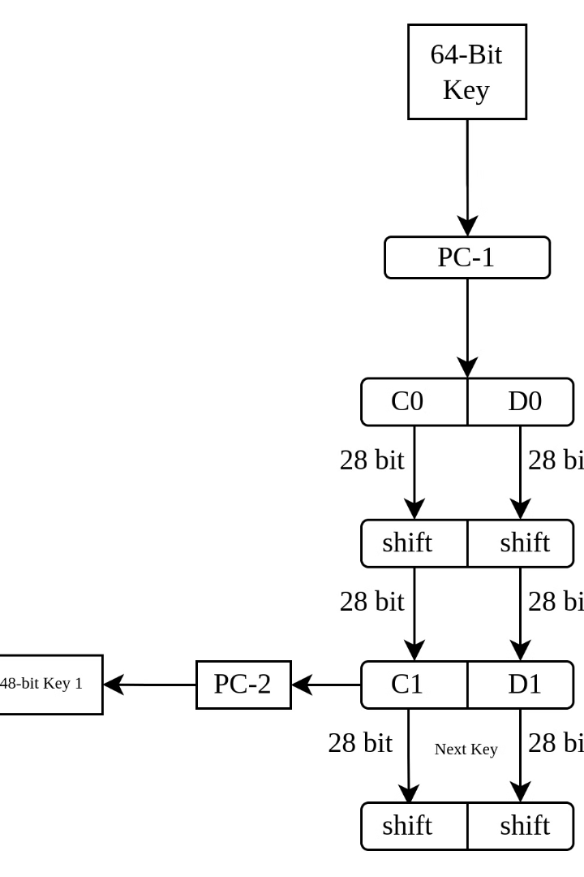
The Intersection of Cryptography and NLP in Theory of Computation
The convergence of cryptography and natural language processing (NLP) within the framework of theoretical computer science presents a rich landscape for exploration and innovation. Cryptography, focused on secure communication and data protection, and NLP, concerned with understanding and generating human language, appear distinct at first glance. However, their intersection yields profound implications for various domains, particularly in the context of secure communication, privacy-preserving computation, and information security. This presentation delves into the fundamental concepts and key applications arising from this intersection.
by Harish Ragav

Slide 2
Secure Communication with NLP
Language-Based Encryption
Privacy-Preserving NLP
One prominent area of research is the development of language-based encryption schemes. These schemes leverage the inherent structure and complexity of natural language to create encryption keys and algorithms that are resistant to traditional cryptanalytic attacks. For instance, the semantic properties of text can be used to generate unique and unpredictable keys, making it difficult for attackers to decipher encrypted messages without understanding the underlying language.
The application of cryptographic techniques to NLP models is crucial for protecting sensitive information during language processing tasks. Differential privacy, for instance, allows researchers to analyze and share insights from large language datasets while preserving the privacy of individual users. Techniques like homomorphic encryption enable computation on encrypted data, ensuring that NLP models can process sensitive information without decrypting it.

Slide 3

Cryptography for NLP Security
1
Secure Communication Protocols
2
Data Integrity and Authentication
Cryptography plays a vital role in ensuring the secure transmission of NLP data between different systems and users. This includes secure protocols for transmitting encrypted messages, data authentication techniques to verify the authenticity of NLP data, and integrity checks to ensure that the data remains unaltered during transmission.
Cryptographic hash functions are essential for verifying the integrity of NLP data. These functions generate unique fingerprints of data, allowing for the detection of any modifications or tampering. Digital signatures, based on public-key cryptography, provide authentication and non-repudiation for NLP data, ensuring that the source of the data can be trusted.
3
Protection Against Adversarial Attacks
4
Data Privacy and Security
NLP models are susceptible to adversarial attacks, where malicious actors manipulate input data to cause the model to generate incorrect or misleading outputs. Cryptographic techniques can be used to mitigate these attacks by verifying the integrity of input data and detecting potentially harmful patterns.
Cryptography is crucial for protecting the privacy of individuals whose data is used in NLP applications. Techniques like secure multi-party computation allow multiple parties to collaborate on NLP tasks without revealing their private data. Homomorphic encryption allows computations to be performed on encrypted data, enabling NLP models to process sensitive information without decrypting it.

Slide 4

Theoretical Foundations
1
Computational Complexity Theory
Complexity theory provides a framework for understanding the computational resources required to solve problems. It informs the design of cryptographic algorithms and the analysis of their security against adversaries with limited computational power. For example, the concept of NP-completeness is crucial for understanding the limitations of certain NLP tasks and the potential for efficient solutions.
2
Information Theory
Information theory provides insights into the fundamental limits of communication and data compression. It helps us understand how much information can be transmitted securely and efficiently in the presence of noise or adversarial interference. Concepts from information theory are essential for designing secure communication protocols and understanding the limitations of NLP models in handling noisy or ambiguous language.
3
Formal Language Theory
Formal language theory provides a rigorous mathematical framework for describing and analyzing languages. It is instrumental in developing NLP techniques for parsing and generating text, and for understanding the limitations of language models in handling complex linguistic structures. This theory forms the foundation for designing secure and efficient NLP systems.

Slide 5
Applications of Cryptography in NLP
Secure Communication in Machine Translation
Privacy-Preserving Sentiment Analysis
Sentiment analysis, which aims to understand the emotional tone of text, can be applied to sensitive data. Cryptographic techniques like differential privacy can be used to protect the privacy of individuals whose opinions are being analyzed while still providing valuable insights into public sentiment.
Machine translation systems often handle sensitive information, such as personal documents or confidential business communications. Cryptography can be used to ensure that translations are performed securely, protecting the confidentiality and integrity of the source and target languages.
Secure NLP in Blockchain Systems
Secure Language Models
Blockchain technology offers decentralized and secure solutions for storing and managing data. Cryptography is essential for securing blockchain systems and enabling privacy-preserving NLP applications. For instance, secure NLP algorithms can be used to analyze and process sensitive data stored on a blockchain without compromising user privacy.
Large language models, like GPT-3, can be vulnerable to attacks that manipulate their outputs. Cryptography can be used to develop secure language models that are resistant to adversarial attacks and ensure that the model's outputs are trustworthy and reliable.

Slide 6




Challenges and Future Directions
Balancing Security and Efficiency
Cryptography often introduces computational overhead, which can impact the performance of NLP systems. Finding a balance between security and efficiency is a significant challenge. Researchers are exploring new cryptographic techniques that are both secure and efficient enough for practical NLP applications.
Developing Practical Solutions
While many theoretical advances have been made in cryptography for NLP, bridging the gap between theory and practice remains a major challenge. Developing practical and scalable solutions that can be implemented in real-world NLP systems is crucial for the widespread adoption of these technologies.
Addressing Ethical Concerns
The use of cryptography in NLP raises ethical concerns, particularly regarding privacy and data ownership. Researchers and developers must be mindful of these ethical considerations and ensure that cryptography is used responsibly to protect individuals and promote a fair and equitable society.

Slide 7



Conclusion: A Promising Future
Enhanced Security
Advanced NLP Capabilities
Transformative Impact
The integration of cryptography into NLP opens new avenues for enhancing security and privacy in language-based applications. This approach safeguards sensitive information, protects users from malicious attacks, and ensures the trustworthiness of NLP outputs.
Cryptography enables the development of more sophisticated NLP models that can operate on encrypted data, paving the way for privacy-preserving analytics and secure communication. This unlocks new possibilities for NLP applications across various domains.
The intersection of cryptography and NLP has the potential to transform industries, from healthcare and finance to education and government. By combining the power of secure communication and advanced language processing, these technologies can drive innovation and address critical challenges in our digital world.

Slide 8
Further Research and Collaboration
Research Areas
Collaboration
Developing new cryptographic techniques specifically tailored for NLP tasks.
Collaboration between cryptographers and NLP researchers is crucial to develop effective solutions.
Exploring the use of homomorphic encryption for secure NLP model training and inference.
Collaboration with industry partners can help translate research into practical applications.
Developing standards and best practices for secure NLP applications.
Collaboration with regulatory bodies can help shape policies and guidelines for the ethical use of cryptography in NLP.

